Slide 1

Centralized Application for Program Divisions for Drug Supply Chain

Slide 2

Process Flow– State Program Role
States Receive Items from CMSS/MSO/Third Party:
A nodal unit receives supplies from various sources, including the CMSS, MSO or third-party vendors.
Enter the Received Items Details in the Generalized DVDMS Application:
After receiving the items, the nodal unit logs the details into the Generalized DVDMS application.
Store Inventory Updated:
Once the items are received, the DVDMS application updates the store’s inventory to reflect the new stock levels.
Issue Items to Sub Stores:
With the updated inventory, items are then issued to sub-stores that require these items.
States receive items from CMSS/ MSO/ Third Party
Enter the received items details in the Generalized DVDMS application
Store Inventory updated
Issue items to Sub Stores

Slide 3
Miscellaneous Process
Add Inventory
Drug Transfer
Local Purchase and Challan Receive
CMSS Stock View

Slide 4
User Role – State Program Role
State Program Role
Demand Mangement | Demand Compilation
Procurement | Local Purchase
 | Local Challan Process
Inventory Management | Drug Inventory View
 | Receive from Third party
 | Release Order Online
 | Issue Desk
 | Acknowledge Desk
 | Issue To Sub Store Off Line
 | Issue to Third Party
 | Breakage and Lost Item
 | Physical Stock Modification
 | Condemnation Register
Drug Transfer | Transfer Request Excess
 | Transfer Request for Shortage
 | Item Wise Online Transfer Detail
 | Item Wise Transfer Acknowledge Desk
Go-Live In Phase - I
Drug Inventory Add /View
Inventory
Drugs Acknowledge (CMSS)
Release Order Online
Breakage and Lost Item
Receive/Issue Third Party
Issue To Sub Store Off Line
Drug Transfer
Item Wise Transfer Acknowledge
Item Wise Online Transfer

Slide 5
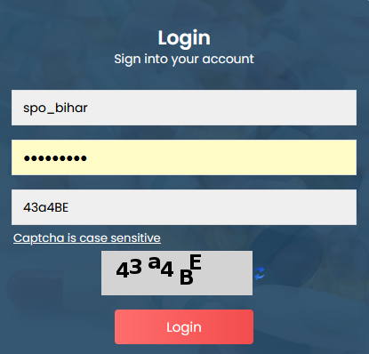
Login Steps
URL: https://dvdmsmscp.uat.dcservices.in/IMCS/login
Username : spo_bihar (State level ID)
Password : admin@123
Each State Programme Officer have their Username/password according to role
Refresh the captcha

Slide 6
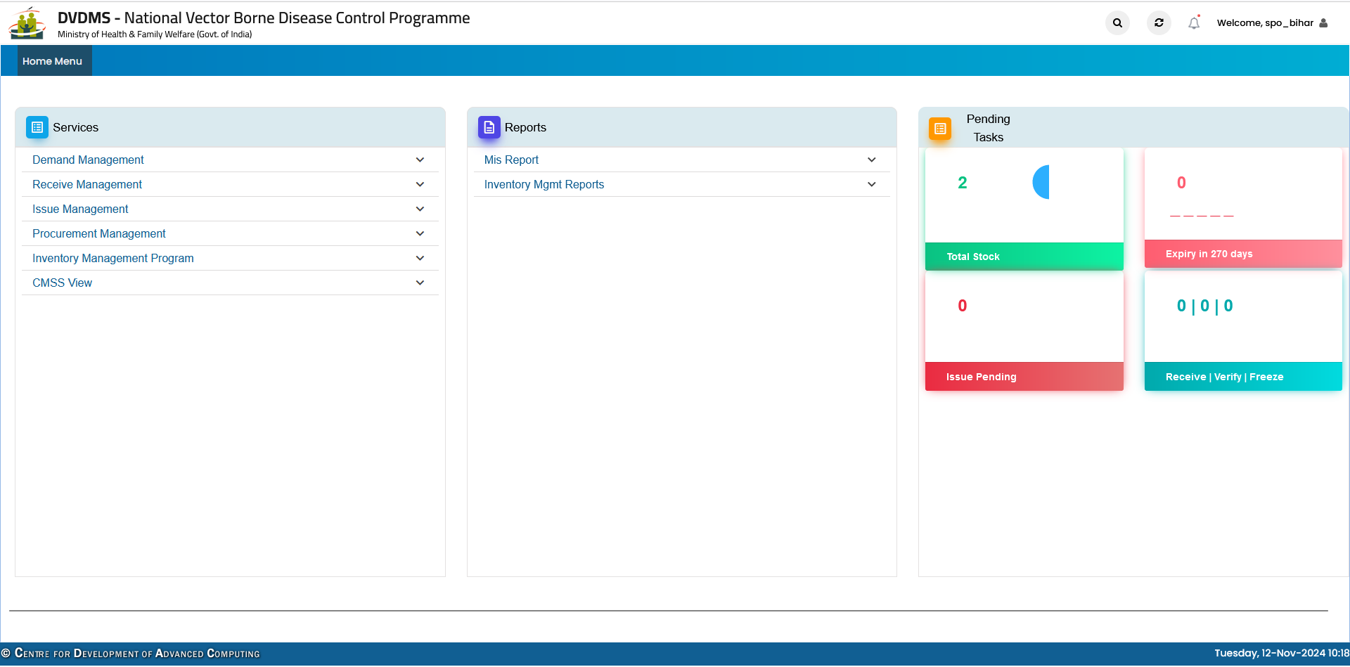
Login Steps

Slide 7
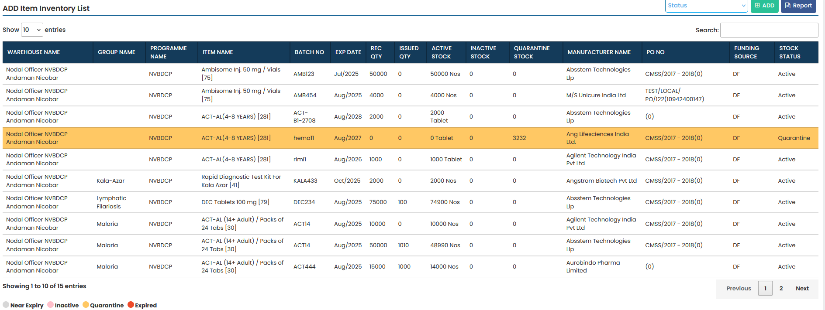
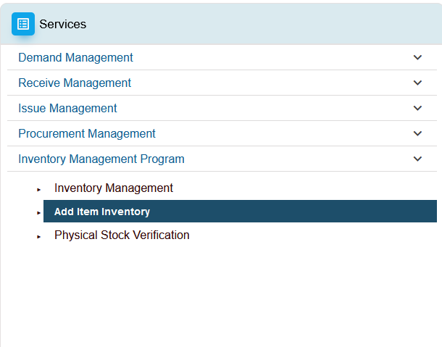
Ground Stock Entry
Ground stock upload—Services/Inventory Management –Add Inventory

Slide 8
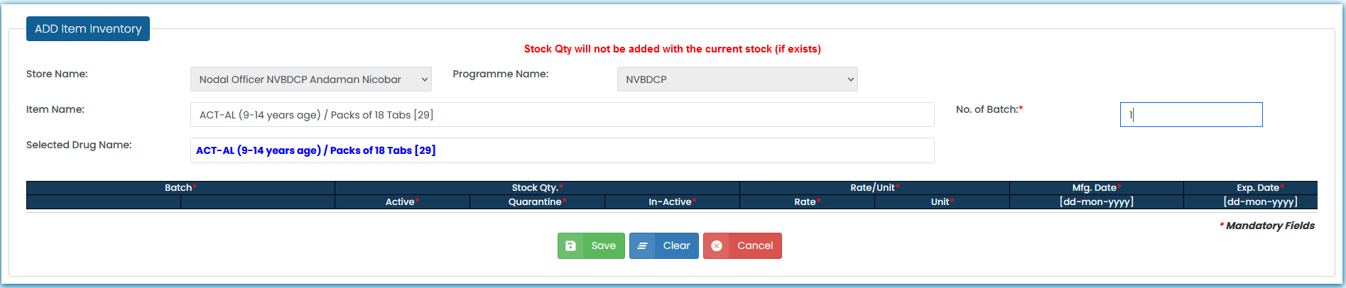
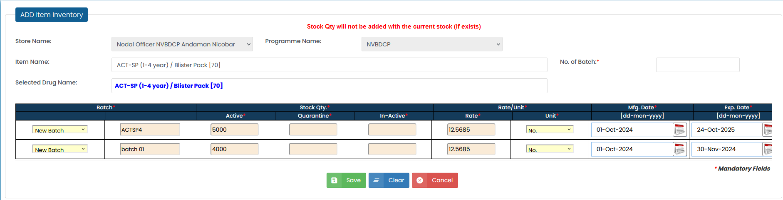
Ground Stock Entry
Add Inventory

Slide 9
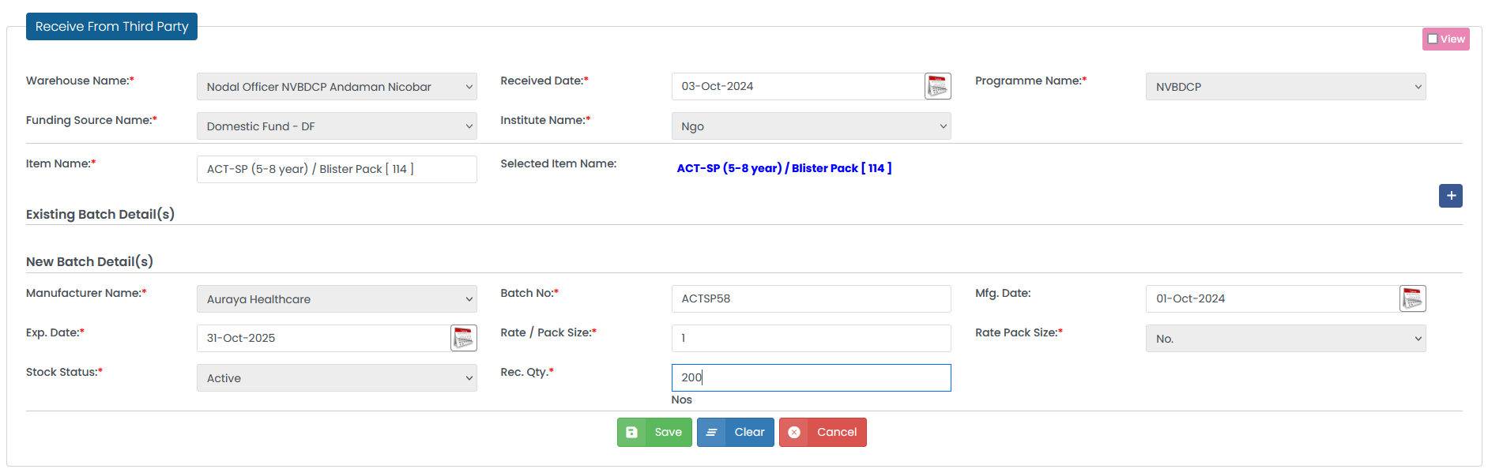
Receive Drugs from - CMSS/Third party/MSO
Receive Third party

Slide 10
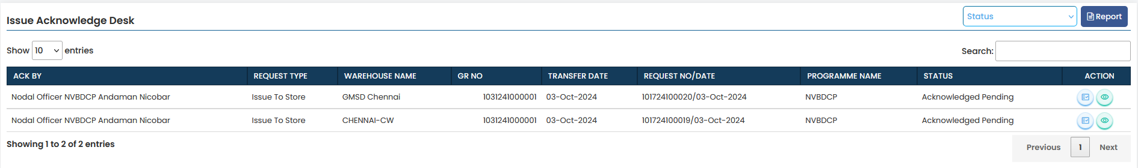
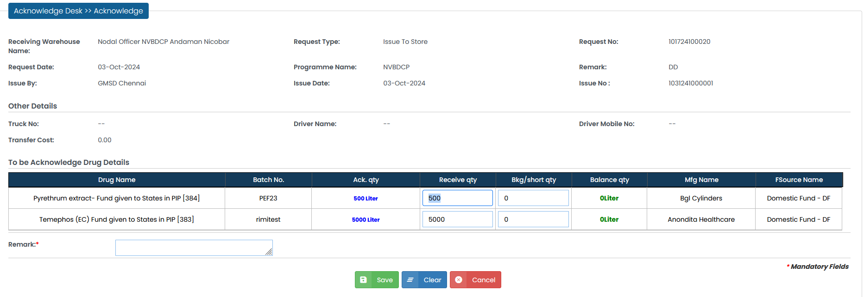
Receive Drugs from - CMSS/Third party/MSO
Receive CMSS/MSO

Slide 11
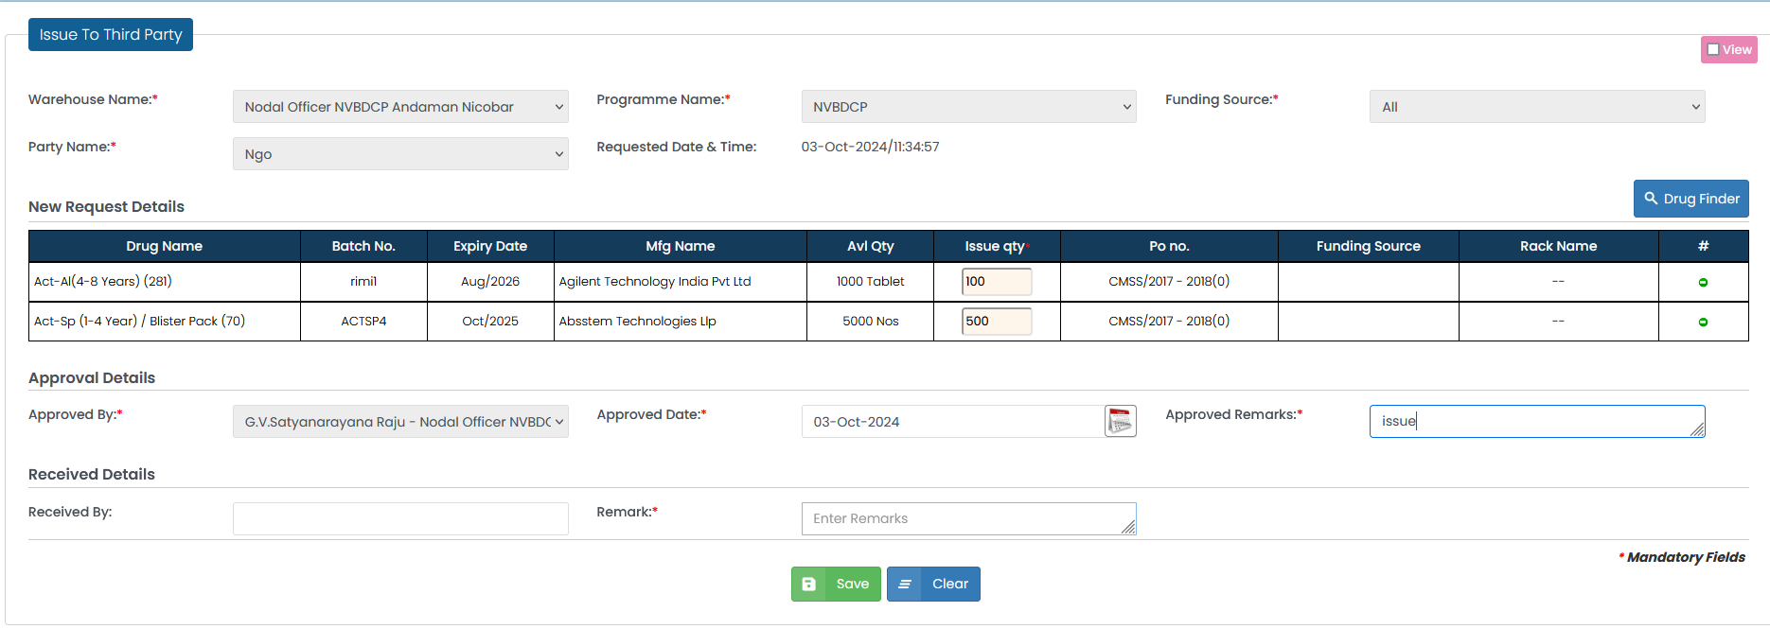
Distribute Drugs to - District/Third party
Issue to Third Party

Slide 12
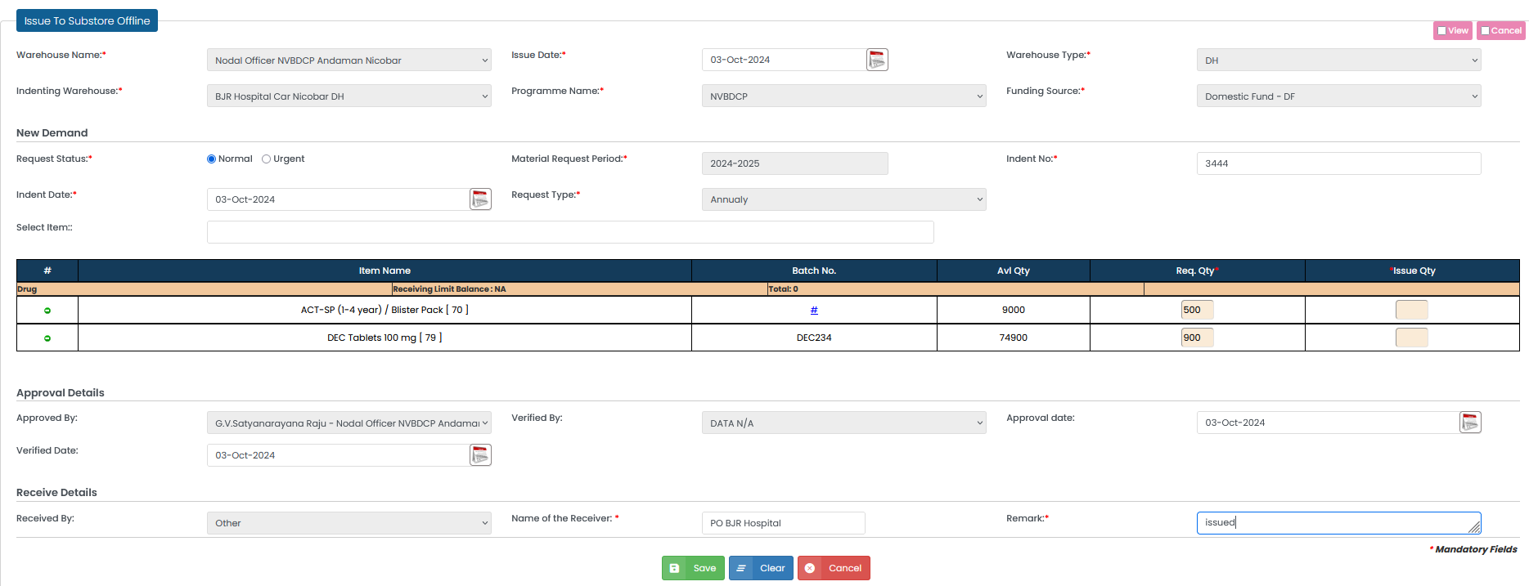
Distribute Drugs to - Districts/Third party
Issue to Sub-Store

Slide 13
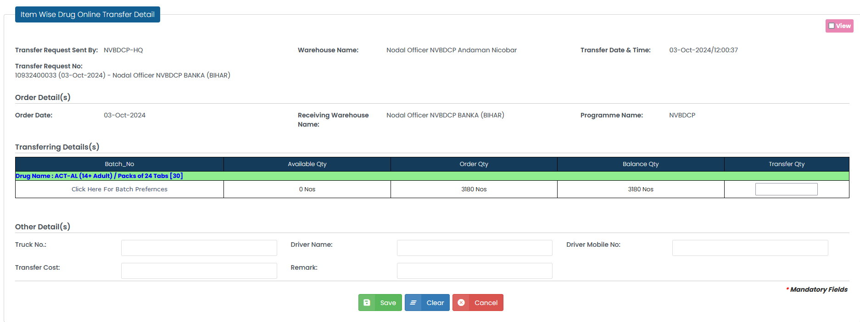
Drugs Transfer
Issue to Nodal

Slide 14
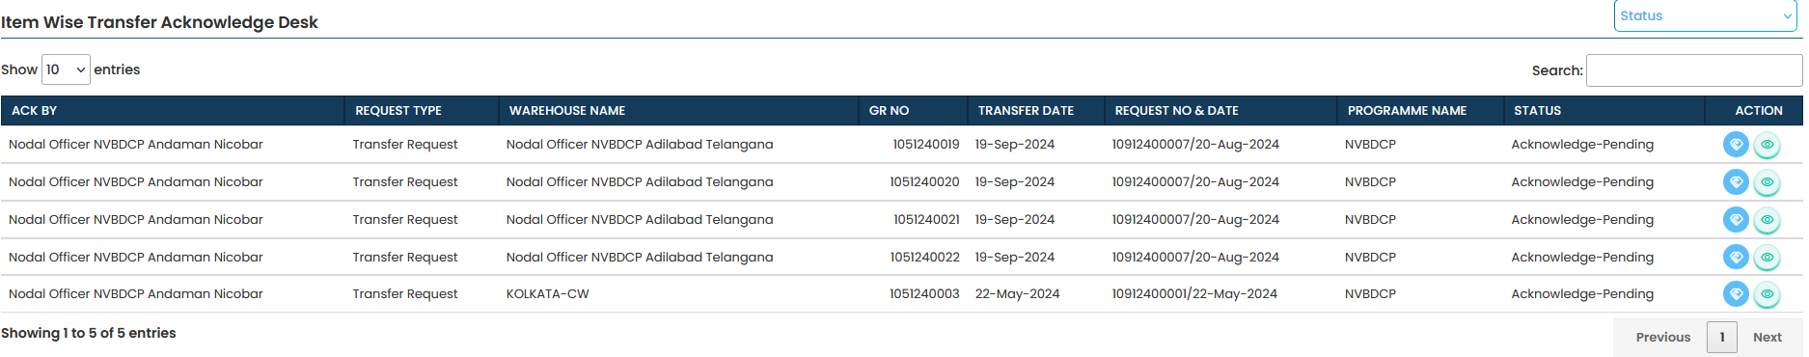
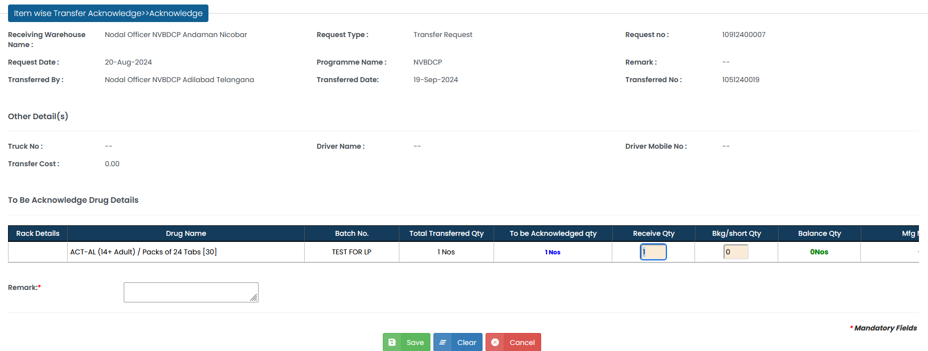
Drugs Transfer Acknowledge
Transfer Receive

Slide 15
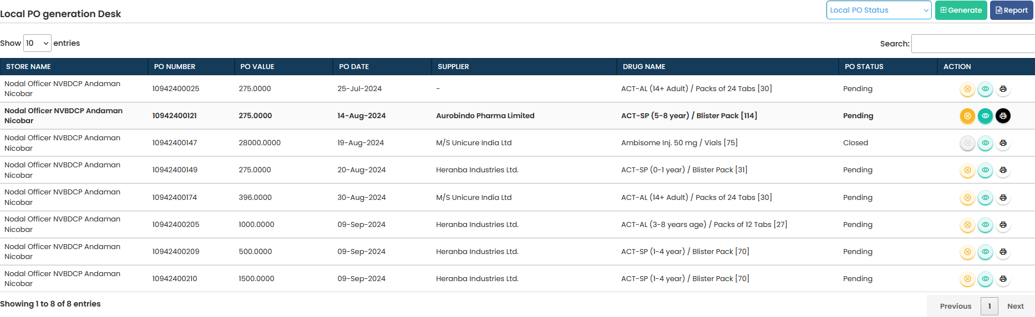
Local PO

Slide 16
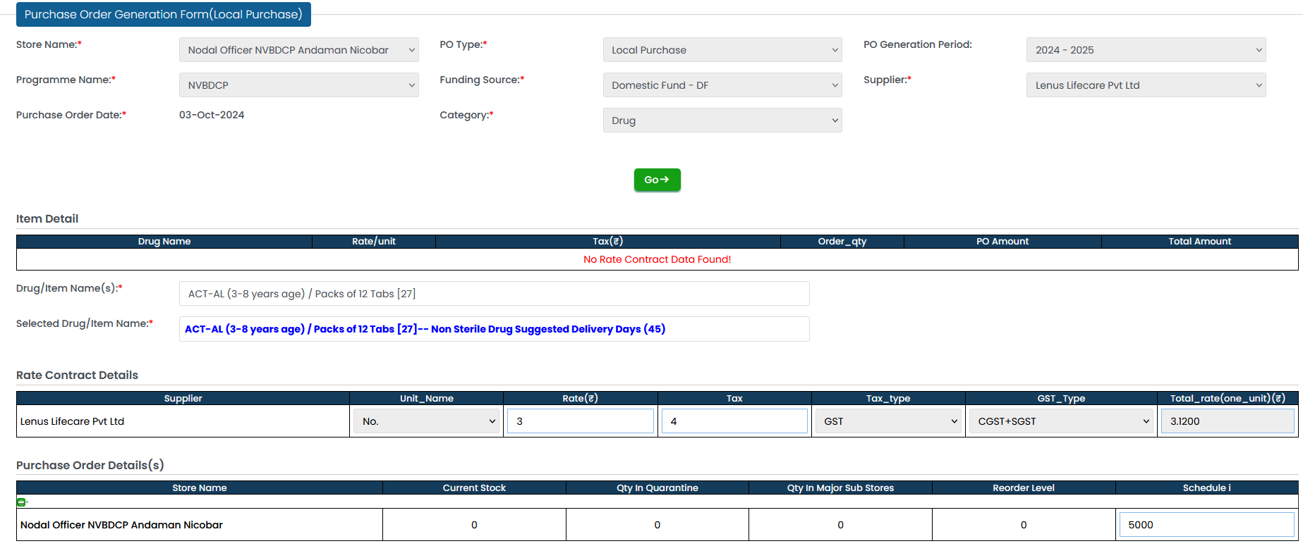
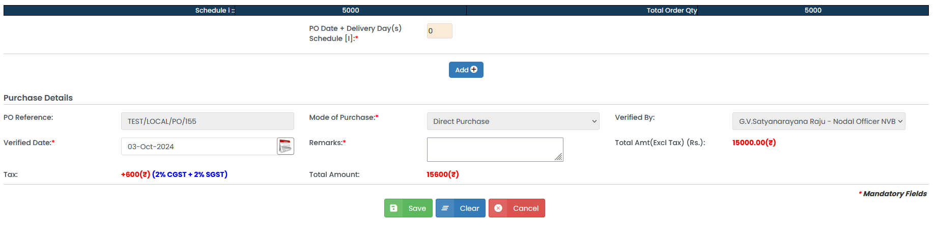
Local PO

Slide 17
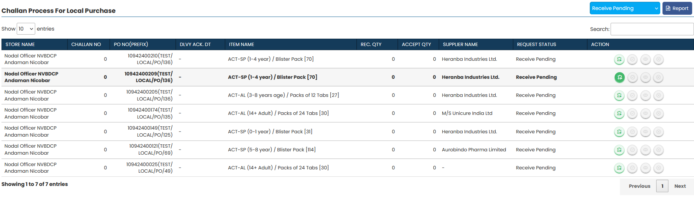
Local PO Challan List

Slide 18
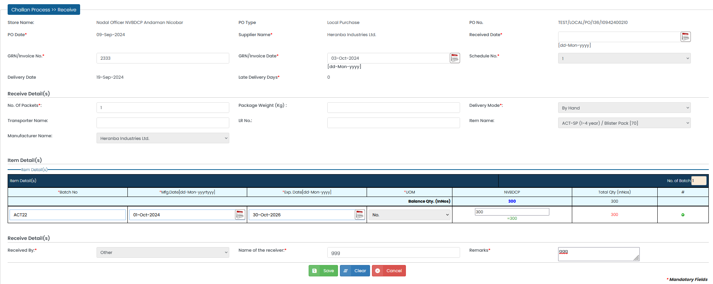
Local PO Challan

Slide 19
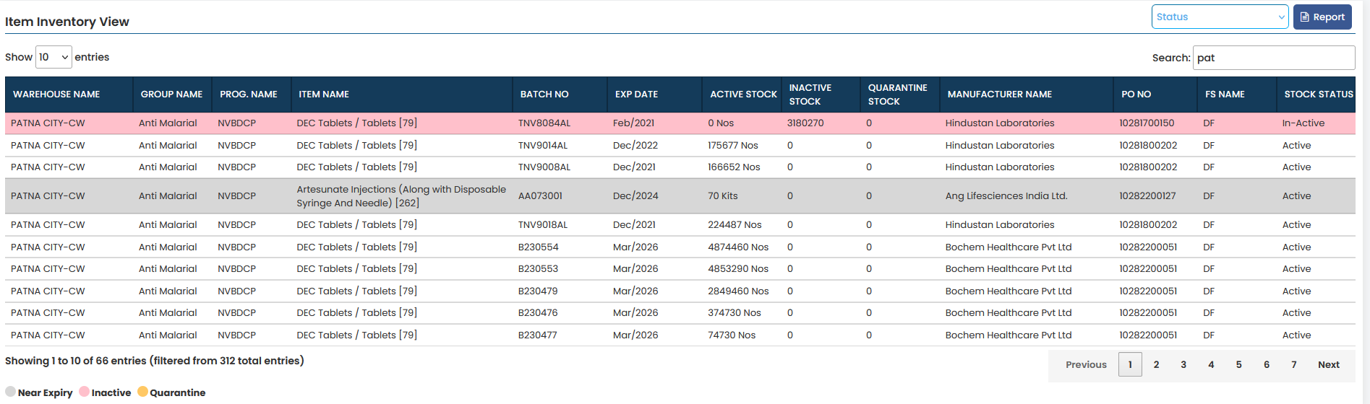
CMSS Stock View

Slide 20
Thank you

